Slide 1
Welcome
WiFi – MSFTGuest
Event Code – msevent362dc
Dave Wentzel (davew@microsoft.com)
James Stento (james.stento@Microsoft.com)
Notes:
`

Slide 2
A Tour of Azure
Notes:
what is azure?
resource groups

Slide 3
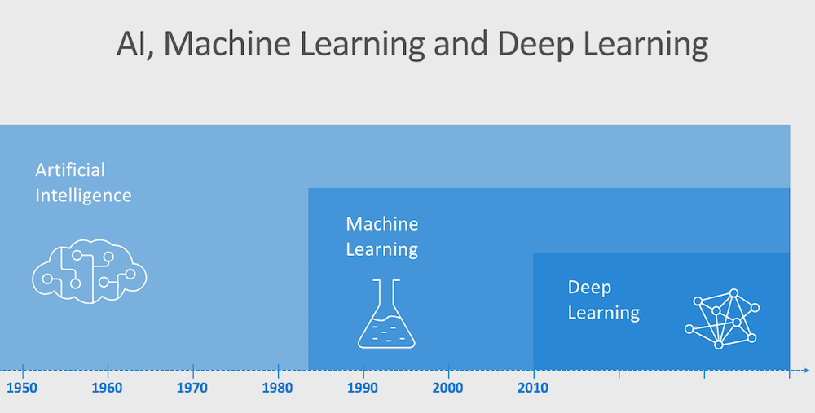
Notes:
Any system that mimics human behavior
Decision trees
Expert systems
Msft definition today
Ai winter due to hype, lack of data and compute
---
Data mining
And lots of data
Math to improve the data
Features and labels
---
Take a stack of algos and apply math
NNs
“layers”

Slide 4
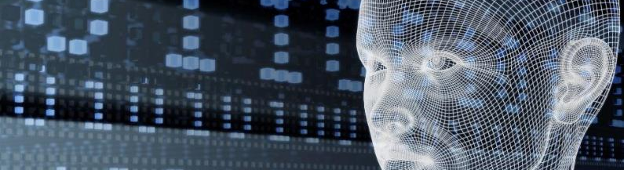


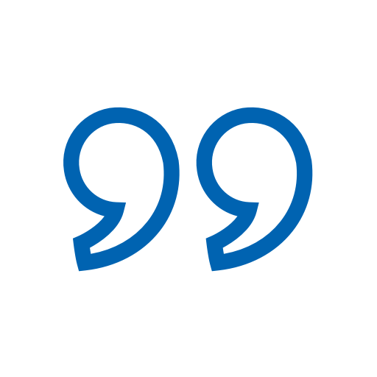


Azure Cognitive Services
Give your apps a human side
Vision
From objects to faces and feelings, enable your apps to analyze still images and video.
Speech
Speak to and hear your users, compensating for environmental noise.
Use with Language for max results.
Language
Analyze text to extract user feeling and intent.
Extract knowledge from existing sources and use it to seed chat bots.
Translate between 60+ languages and growing.
Search
Access billions of web pages, images, videos, and news with the power of Bing.
Knowledge
Preview the newest capabilities from analyzing time series to personalization over reinforcement learning.

Slide 5
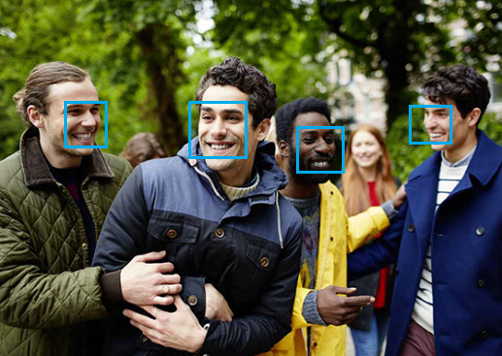
Vision – Face Azure Cognitive Services
Face Detection
Face API detects up to 64 human faces with high precision face location in an image. And the image can be specified by file in bytes or valid URL.
Face Recognition
Face recognition is widely used in many scenarios including security, natural user interface, image content analysis and management, mobile apps, and robotics. Four face recognition functions are provided: face verification, finding similar faces, face grouping, and person identification.
Key features:
Detect human faces and compare similar ones
Organize images into groups based on similarity
Identify previously tagged people in images

Slide 6
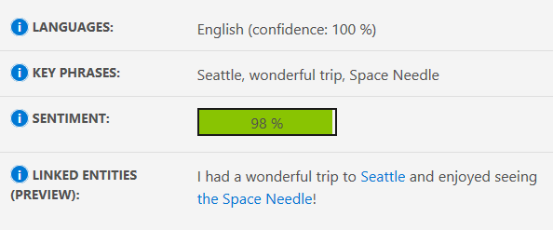
Text Analytics Azure Cognitive Services
Extract insights from customer feedback and social network postings.
I had a wonderful trip to Seattle and enjoyed seeing the Space Needle!
Links backed by Wikipedia in select languages
submit up to 100 calls per minute, each with up to 1,000 documents of up to 5,000 characters each
Notes:
azure cognitive services

Slide 7
Text Analytics Demo
Notes:
“plans” : use free tier
text analytics
keys
endpoints

Slide 8
Azure ML Studio and Basic Machine Learning and Data Science

Slide 9
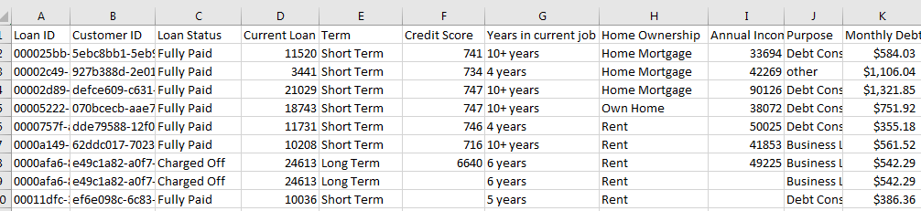
Understanding the “Shape” of Data
Will this loan be charged off?

Slide 10
Terminology
Training Data : A set of samples (table of data)
Testing Data: A set of samples (training data) set aside to test your model
Features: Individual columns in our data set. These might be used to help make our prediction, or not.
Factors: aka features
Categorical Features: features with a known domain of values
independent variables: aka features
Feature Engineering: manipulating existing data to make it more meaningful
very similar to ETL
Data Wrangling/Munging: ETL
Label: Historical outcome or result related to a set of samples.
What you are trying to predict.
aka, “the target” or “the dependent variable”, or “response”
Notes:
Spurious correlations

Slide 11
Terminology
Learner: Machine learning algorithm
Supervised Learning: we know the label (”will this loan chargeoff?”)
you “train” these models with training and test data
Unsupervised Learning: we don’t know the label (“Recommendation engines”)
the learner tries to find patterns
ex: anomaly detection, clustering
Correlation vs Causation: ML *cannot* tell what caused what
Leakage
you accidentally used the response to predict the response
(you used the answer to predict the answer)
ex: you use GPA to predict if a student will fail
these are often “masked” or “derived” and are hard to find
happens possibly when your “relative influence” gets to high (70%?)
Notes:
Spurious correlations

Slide 12
Data science questions
How much / how many? Regression
supervised. ”Given my past sales, what will my sales be next quarter”
2. Which category? Classification
supervised. “Will this loan chargeoff”
3. Which groups? Clustering
4. Is it weird? Anomaly Detection
5. Which option? Recommendation

Slide 13
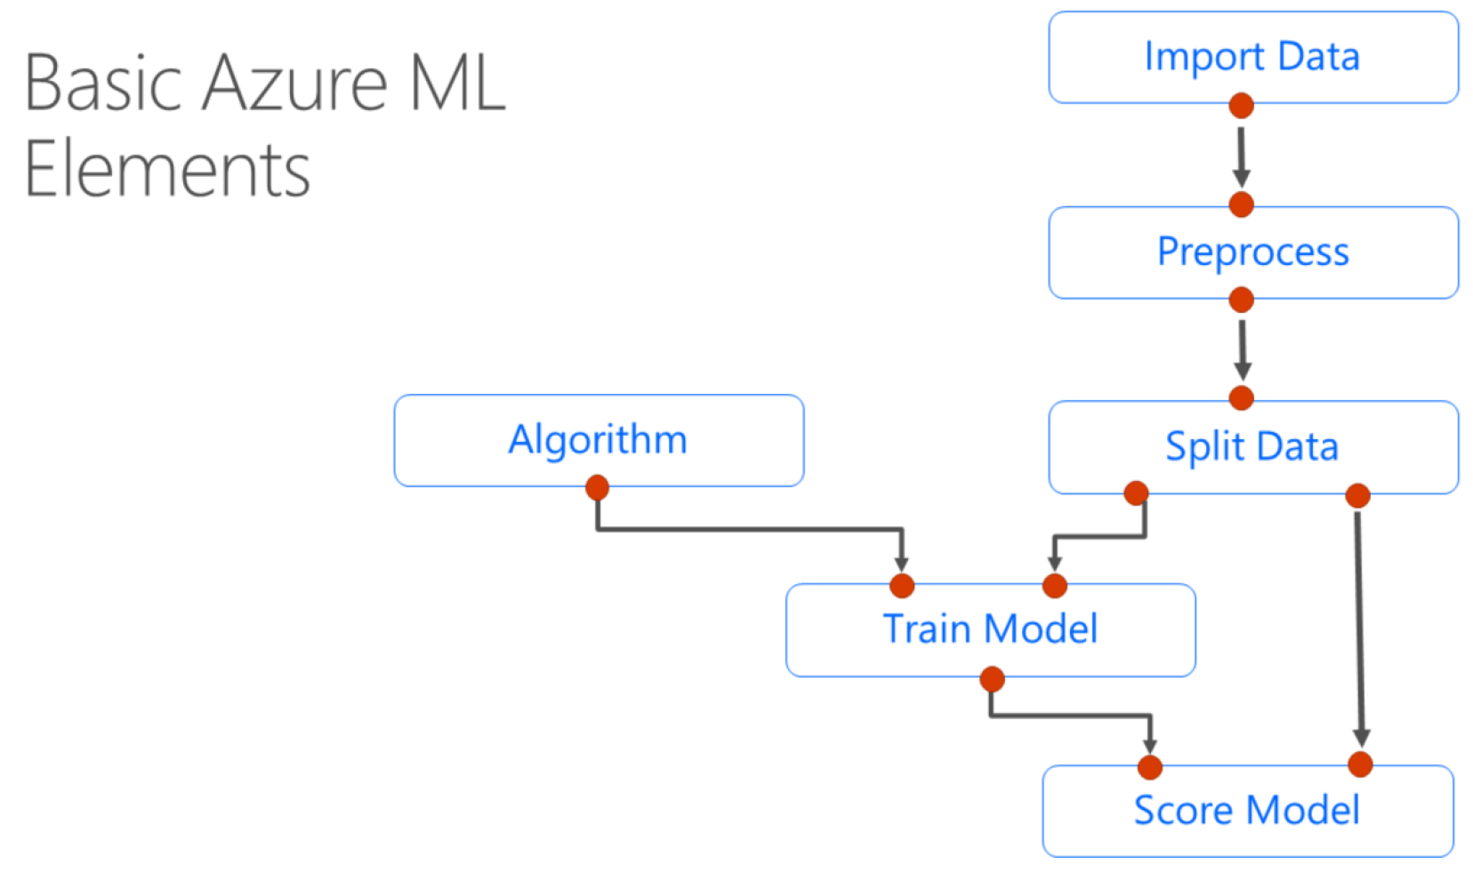
Azure ML

Slide 14
Azure Machine Learning – Studio
https://studio.azureml.net
Notes:
do dave@davewentzel.com demo
then do davew@Microsoft.com demo

